Slide 1

Bond Force®
by Tokuyama Dental America Inc.

Slide 2
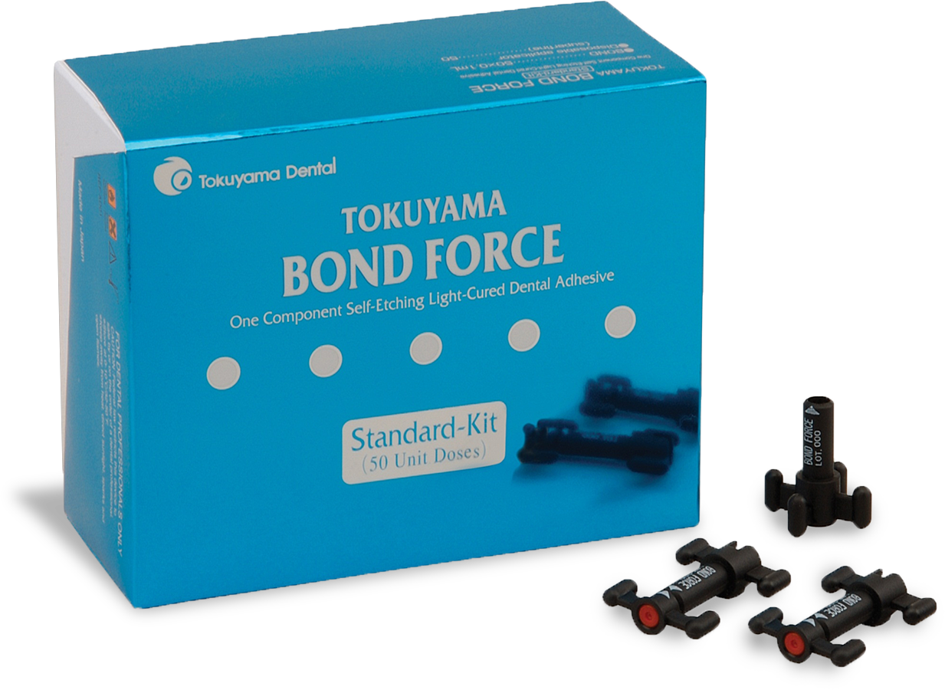
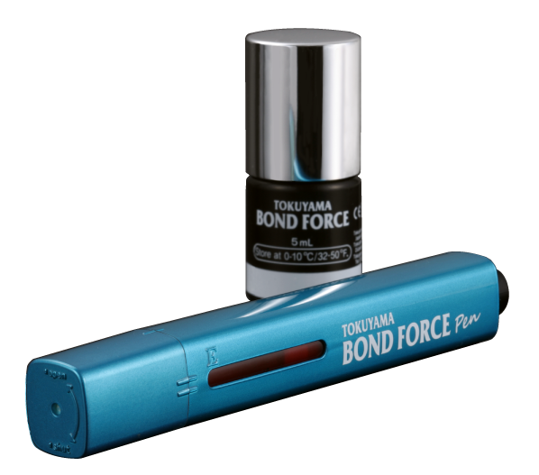
Seventh Generation Adhesive
Bond it right the first time, every time!
A seventh generation single component, self-etching, fluoride releasing bonding agent
Indications:
Bonding of light or dual cured composite material to cut/uncut enamel and dentin and for fractured porcelain/ composite repair

Slide 3
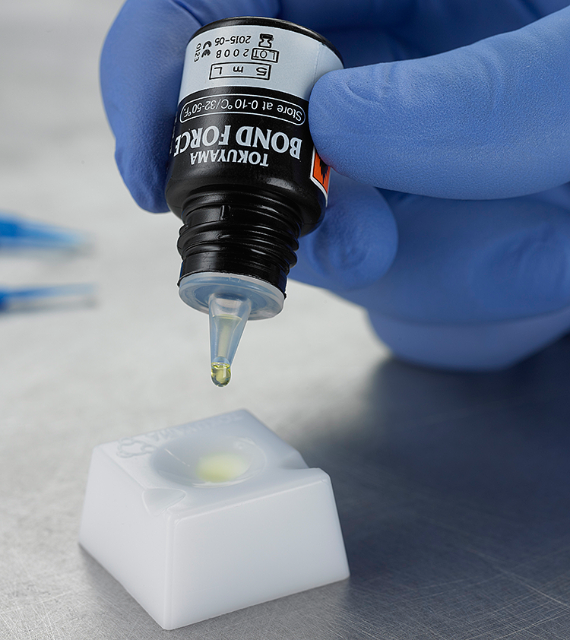
Seventh Generation Adhesive
Simple to use
  Apply, dry, cure
  Easy application
    Pen
    Bottle
    Unit Dose
Low film thickness
Low technique sensitivity -- moist, wet or dry
Excellent bond strengths
to enamel and dentin
Reliability in one system

Slide 4
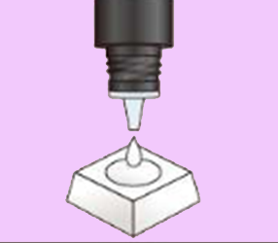
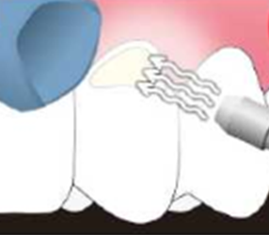
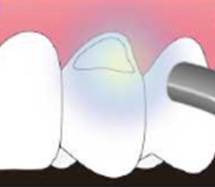
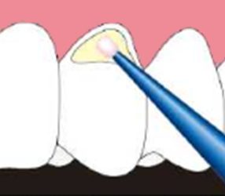
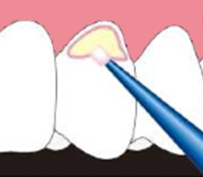
Simple
Apply
Dry
Cure
20
secs.
10
secs.
10
secs.
Dispense
Apply weak air for five seconds then strong air for five or more seconds
Light cure
Apply
BOND
FORCE
Rub the margins for 20 seconds

Slide 5
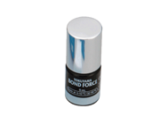
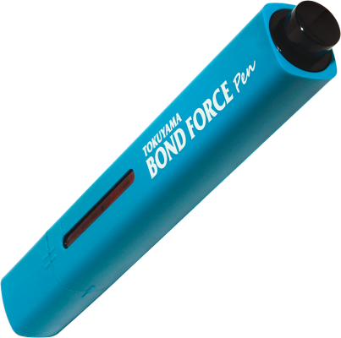
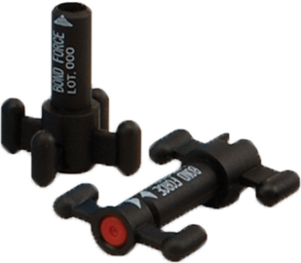
Simple
Bond Force®
Bottle
Bond Force®
Pen
Bond Force®
Unit Dose
The traditional package for dispensing
5mL bottle
Bond Force® pen provides uniform quantities
Remaining liquid
can be monitored through the indicator
2mL pen
Easy, single, application
50 unit doses
(0.1mL x 50)

Slide 6
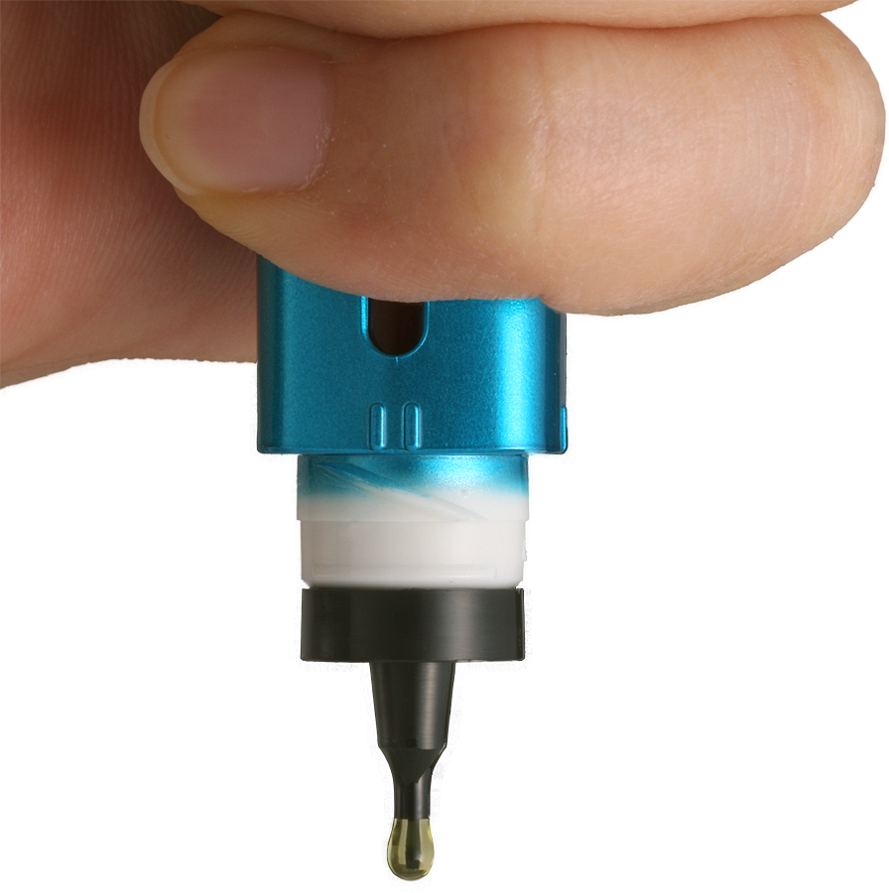

Bond Force® Pen
Accurate and easy two-click dispensing system
No more waste, No more stress.
  The Easy Click Dispensing always delivers
  minimum volume and uniform drops
  2 -3 clicks are required to dispense one drop
Speedy Cap Opening/Closing
  Only a 90-degree turn of the cap enables speedy cap-opening
  and closing
Level Indicator
  Remaining liquid can be monitored through the indicator

Slide 7
Technique
Bond Force® is not technique sensitive -- in fact, tooth desiccation provides the highest bond strength
Effect of Tooth Surface Moisture (Enamel)
25
20
15
Tensile Bond Strength/MPa
10
5
0
Tri S Bond
Bond Force®
G-Bond
XenoIV
iBond
OptiBond
All-In-One
■ Dry ■ Moist ■ Wet
Moisture: Damp tooth surface (left to stand for 1 hour at 37˚C at 100% humidity); Wet: Tooth surface with water droplets
Tested in these conditions; Dry: Air-dried tooth surface

Slide 8
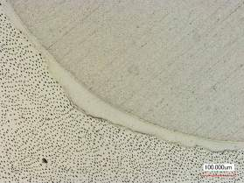
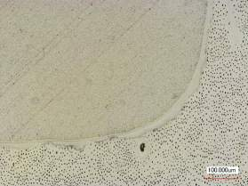
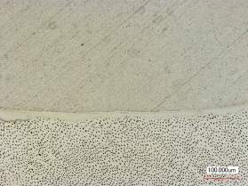
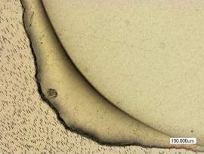

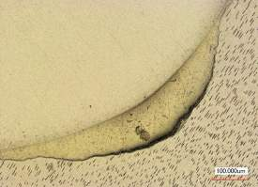
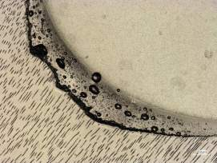
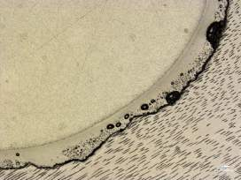
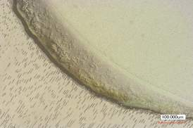
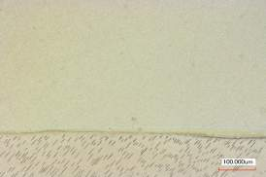
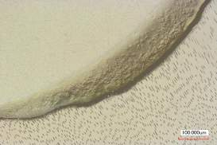
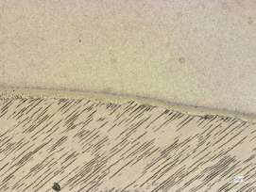
Bond Strength
Testing revealed Bond Force® provides benefits where others fail
Tokuyama Bond Force®
A uniform thin bonding layer was formed even around the corner and the edge of the cavity adaptation
The bonding layer is combined with both resin composite and the cavity wall remarkably, since no gaps can be observed at the interface
Bonding Layer (12.8um)
Resin Composite
Dentin
Easy Bond (3M ESPE)
G-aeniel Bond (GC)
Single Bond Plus (3M ESPE)
①
Bonding Layer
Bonding Layer
Bonding Layer
②
③
④
Composite Resin
Composite Resin
Composite Resin
Dentin
②
Dentin
③
④
Dentin
The bonding layer using Easy Bond became thick and pooled around the corners of the preparation
Voids appeared between the bonding layer and composite resin
The bonding layer of G-aenial Bond is full of porosity around the corners of the preparation
Voids appeared between the bonding layer and composite resin
The bonding layer became thick and pooled around the corners of the preparation
There was slight abrasion that was observed in the bonding layer after being polished

Slide 9
Tokuyama’s Bond Force® provides incomparable strength
Micro Tensile Bond Strength (Mpa)
Adhesive
Bond Force®
AdheSE One
Brush & Bond
G-Bond
Tri-S Bond
Dentin
Uncut Enamel
Cut Enamel

Slide 10
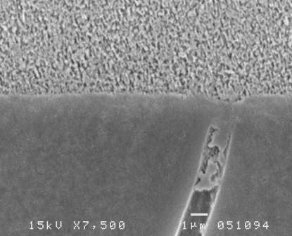
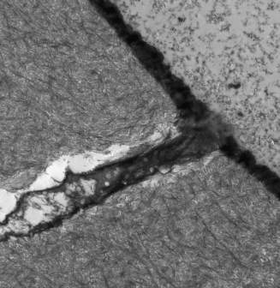
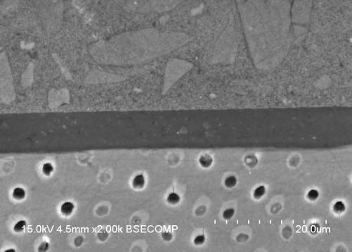
Film Thickness
Bond Force®’s thin, tough Hybrid Layer creates a strong adhesion to dentin
×2000
BOND FORCE
BOND FORCE
8μm
Dentin
20μm
50μm Resin
Tag Penetration
0.2-0.5μm
Resin-Dentin
Hybrid Layer
Film Thickness
Case courtesy: Prof. Tagami, Tokyo Medical and Dental University

Slide 11
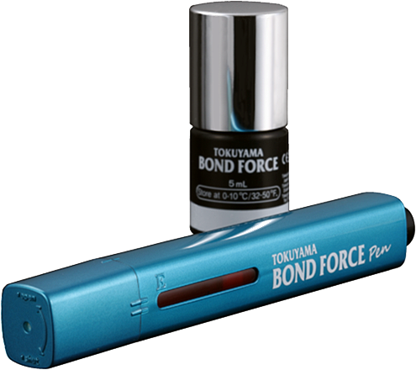
Enhance Your Practice with Tokuyama’s Bond Force®
Faster, easier, stronger
Simple to use
Not technique sensitive (Works great under any surface moisture conditions)
Incomparable strength
All in one delivery system

