Slide 1

Estelite Omega
“Simply Perfect”

Slide 2
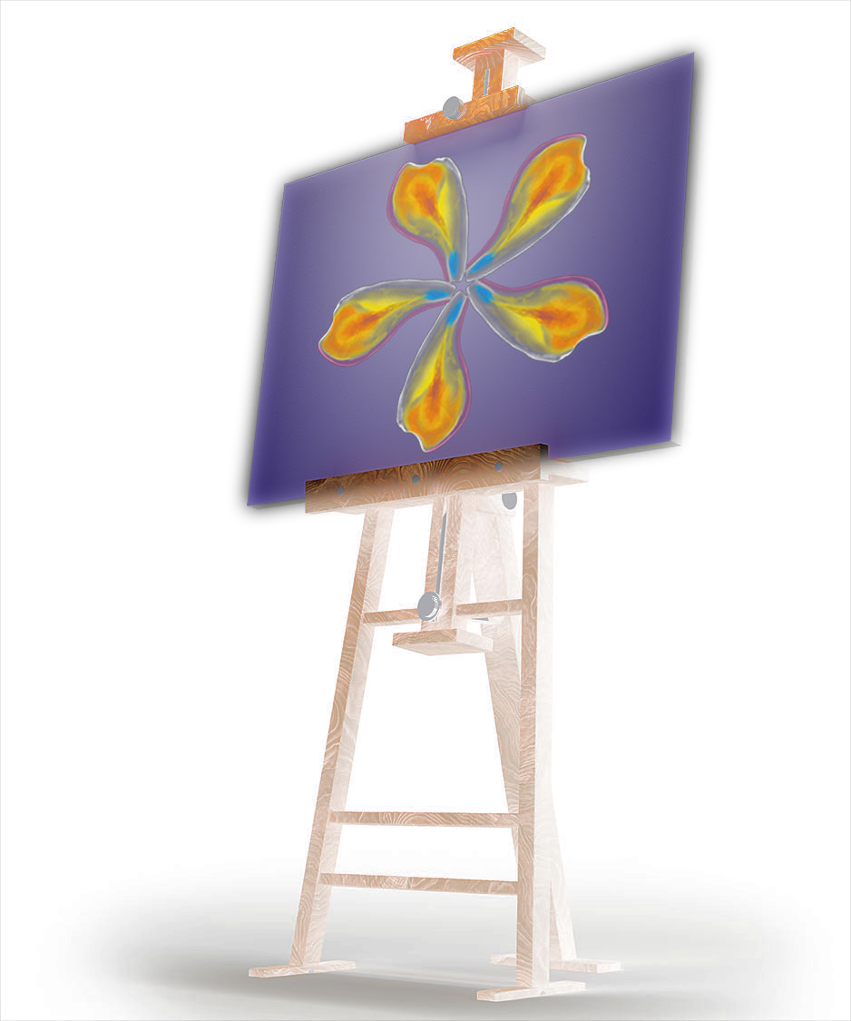
“A painter should begin every canvas with a wash of black, because all things in nature are dark except where exposed by the light.”
– Leonardo daVinci

Slide 3
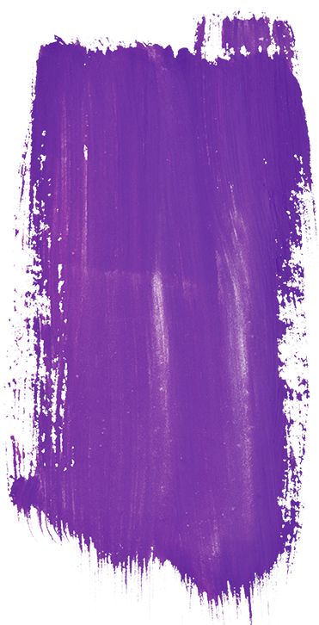

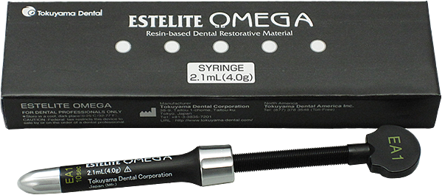
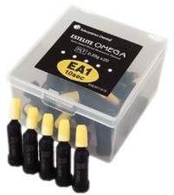
Introducing Estelite Omega for the artist seeking perfection
A 100% spherically filled supra-nano composite for esthetic restorations
Developed and collaborated with renowned esthetic restoration expert Dr. Newton Fahl, Jr.
Dr. Newton Fahl, Jr., D.D.S., M.S.
Indicated for:
Anterior and Posterior Restorations
Composite Veneer
Diastema Closure
Composite/Porcelain Repair
MCG-Hinman Foundation fellow
2008 President´s Award for Best Teacher (American Academy of Esthetic Dentistry)
2011 Excellence in Cosmetic Dental Education (Award American Academy of Cosmetic Dentistry)

Slide 4

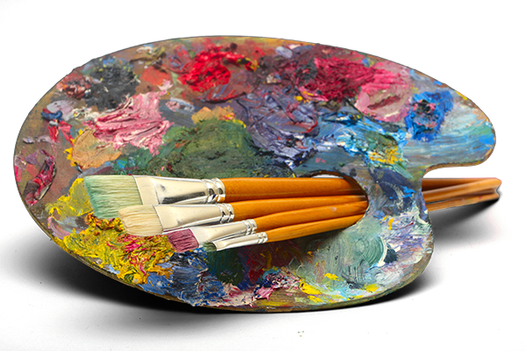
A master’s tool kit doesn’t need to be complex to create a masterpiece

Slide 5
The key to restorations that mimic the opalescence of natural teeth
Hue (color)
Chroma
Value
A color that reflects off an object
Saturation
of the hue
The brightness or darkness of color

Slide 6
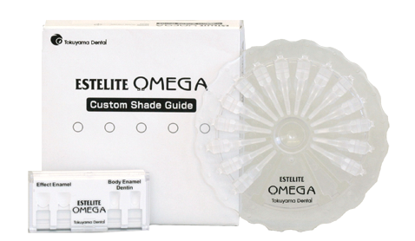
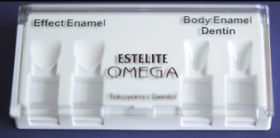
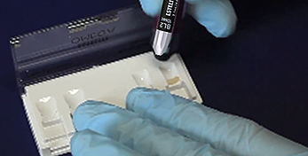
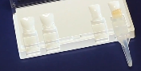
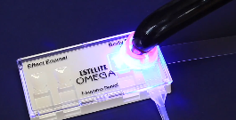
Perfection without guessing with Estelite Omega’s Custom Shade Guide
Most accurate shade matching
made from the same composite
used in patient's mouth
Custom made by you
personalize it to contain only
the shades you use
Versatile, all-in-one system
Works with any brand
of composite system
Organized and personalized
organize your shade guide for your own chair-side convenience
Tooth Mold
Fill with Composite
Insert Handle
Light Cure

Slide 7
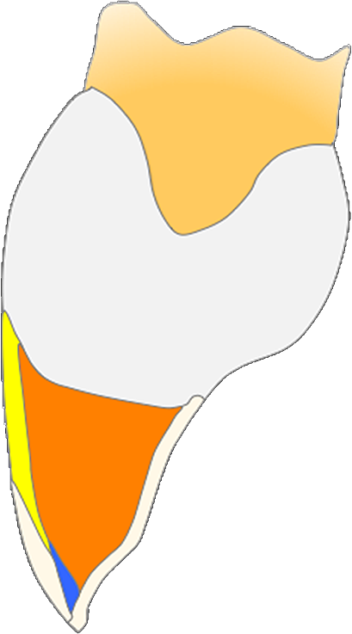


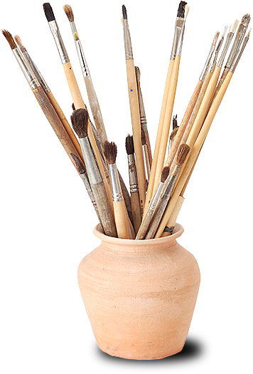



Layering will enable you to create a perfect restoration
Body Enamel
EA1
EA2
EA3
EB1
Milky-White
Trans
MW
TRANS
Body Enamel
Dentin
or
Bleach
DA1
DA2
DA3
Dentin
Bleach
Trans
Milky-White
BL1
BL2

Slide 8
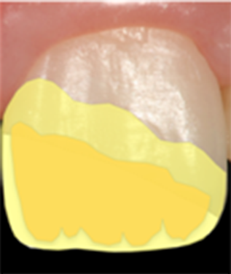
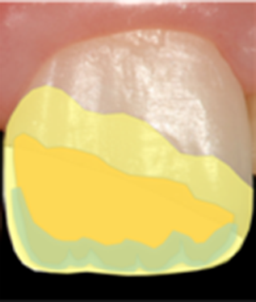
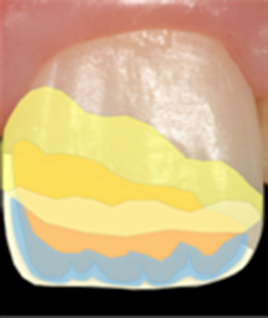
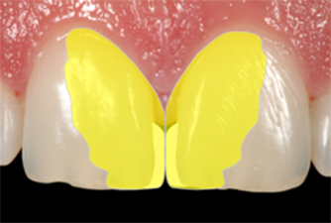
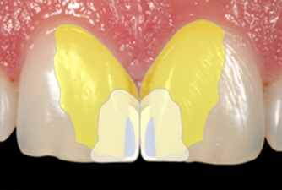
Works of art
Class IV restorations
3-layer approach
4-layer approach
5-layer approach
Minimal translucency and dentin mamelon effects at incisor third
Moderate translucency and dentin mamelon effects at incisor third
Maximum translucency and dentin mamelon effects at incisor third
Diastema closures
2-layer approach
4-layer approach
Minimal or no translucency/effects at incisor third
Maximum translucency/effects at incisor third
■ Milky White Semi-Trans Enamel ■ Dentin ■ Translucent Enamel ■ Body Enamel

Slide 9
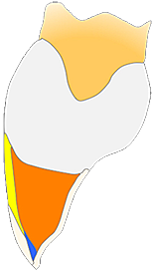
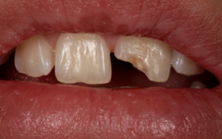
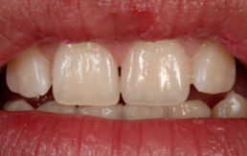
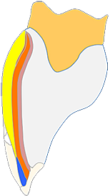
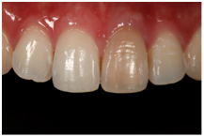
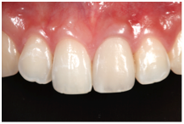
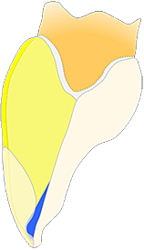
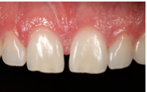
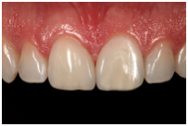
Challenging cases featuring Estelite Omega
Clinical Cases as performed by Dr. Newton Fahl, Jr.
Before
After
Class IV
Restoration
Direct
Veneer
Diastema
Closure
All cases by Dr. Newton Fahl, Jr.

Slide 10
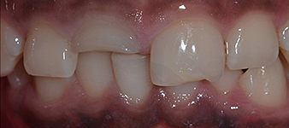
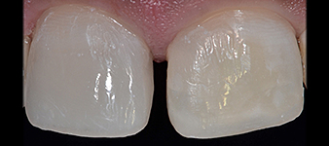
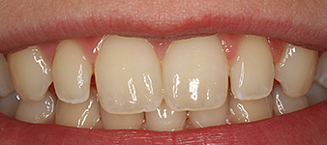
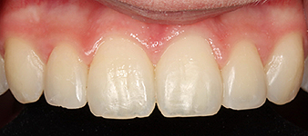
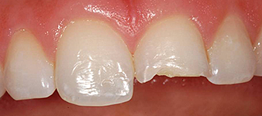
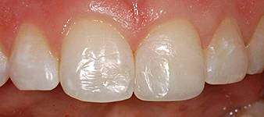
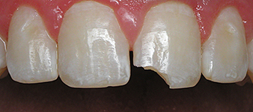
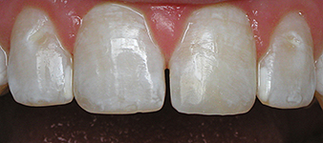
Challenging cases featuring Estelite Omega
Before
After
Class IV Fracture on #8, restored with two-layers
Performed by: Dr. Rodrigo R. Maia, DDS. MS. Ph.D,
and Dr. Sandra Guzmán-Armstrong, DDS, MS
Diastema Closure on #8 and #9, and mesial/distal on #7 and #10
Performed by: Dr. Jonathan Adams, DDS
Large Class IV Fracture on
tooth #9
Performed by: Edward M. Narcisi, D.M.D.
Class IV Fracture on #9, textured to match natural anatomy using Estelite Omega
Performed by: Dr. Robert Antmann, DDS

Slide 11
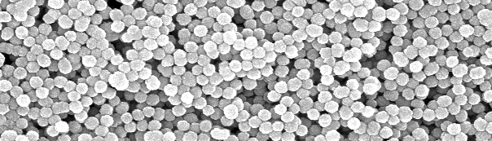
Spherical filled supra-nano composite provides numerous benefits
Simple
Beautiful
Lasting
  Efficient superior shade blend
    One shade may integrate with up to 10 shades, reducing inventory costs
    No shade shift for predictable before and after curing
  Exceptional handling properties for ease of use
  High diffusion for a superb blend with surrounding teeth
    Extreme resistance to slump, for anatomical creation at your pace
    High gloss for initial and long-term polish retention
  Enduring stability without harming opposing teeth
  Low 1.3% volumetric shrinkage to resists marginal leakage
  Low shrinkage stress for lasting patient comfort
  Retained levels of surface smoothness and reduced abrasion for long-term wear resistance
Estelite Omega
Supra-Nano spherical

Slide 12
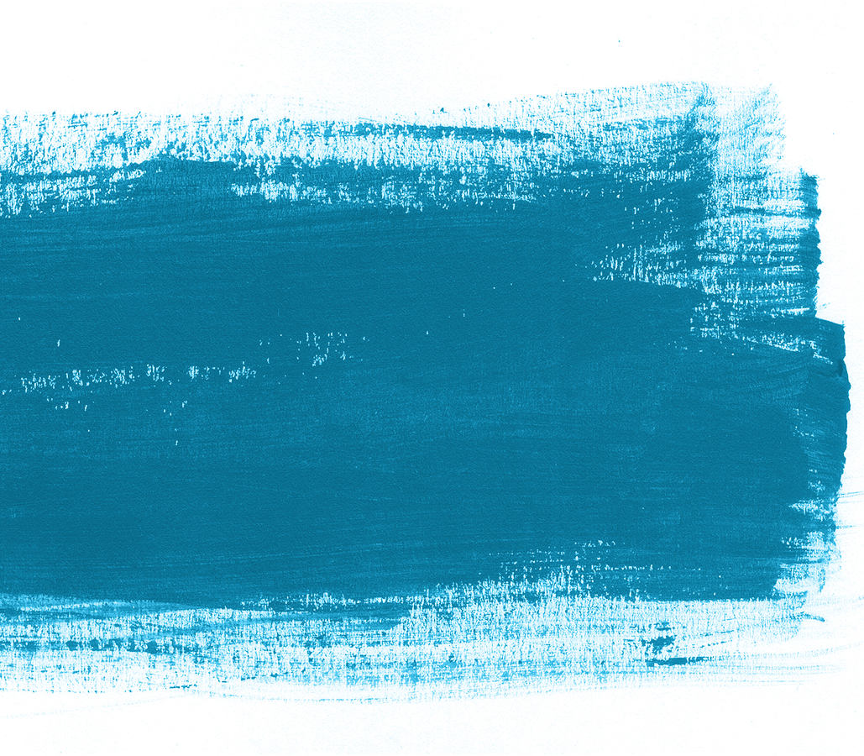
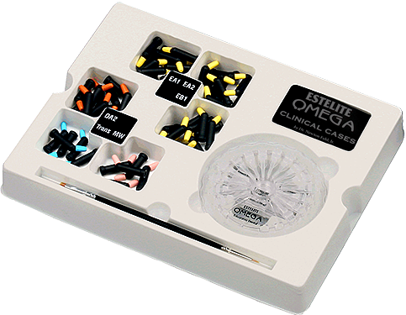
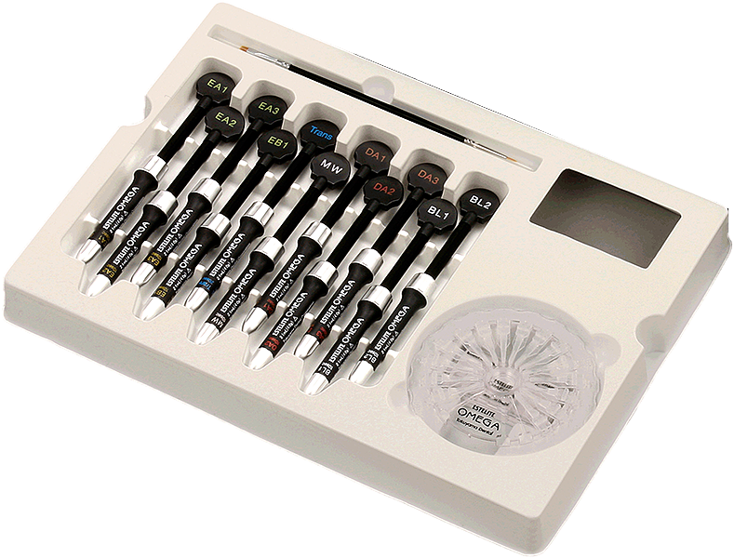
With a tooth as your canvas, we provide one simple kit to create with
Clinical Cases (DVD)
Clinical Guide (CD)
Restoration
Techniques (Card)
11 syringes
  E A1, E A2, E A3, E B1
  D A1, D A2, D A3
  MW, Trans, BL 1, BL 2
Custom Shade Guide–x1
Brush–x1
Clinical Cases (DVD) –x1
Clinical Guide (CD)–x1
Restorative Techniques (Card) –x1
Instruction–x1
Brush
Brush
Custom
Shade Guide
Both a Deluxe kit or a Basic kit are available in PLT or Syringe

Slide 13
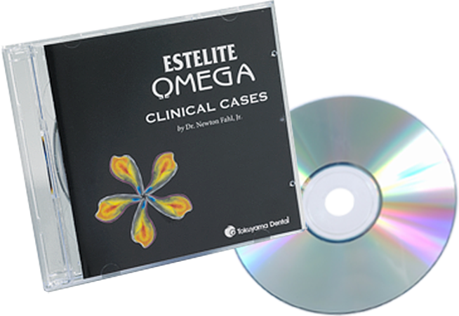
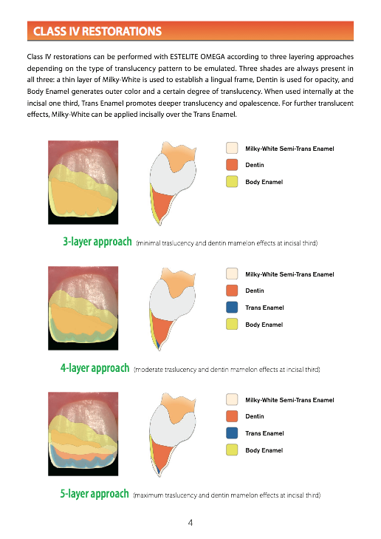
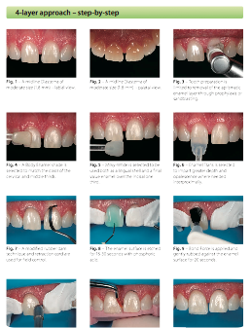
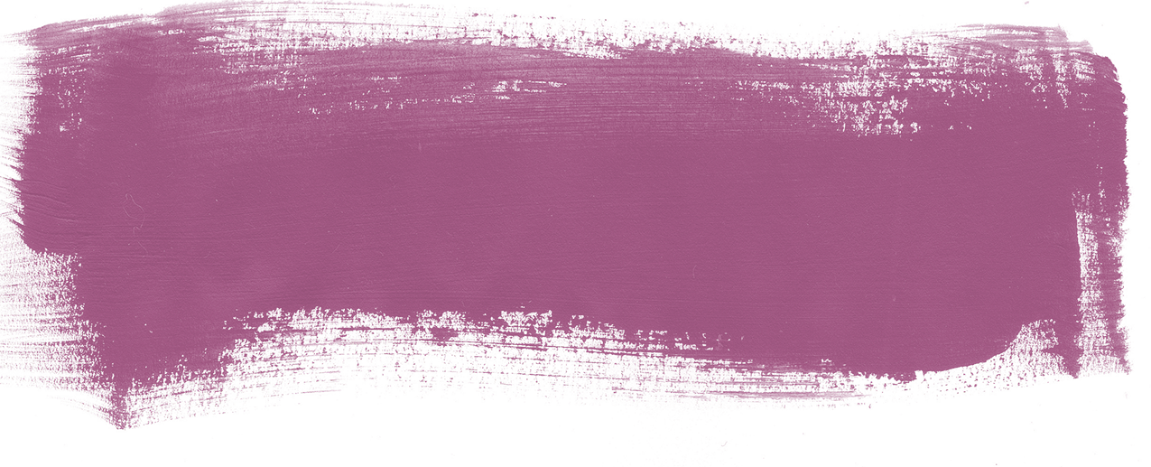
Step-by-step DVD guide featuring Dr. Fahl’s instruction helps you create your own art
Clinical Guide
includes 3 different layering approaches
for various
translucency patterns

Slide 14
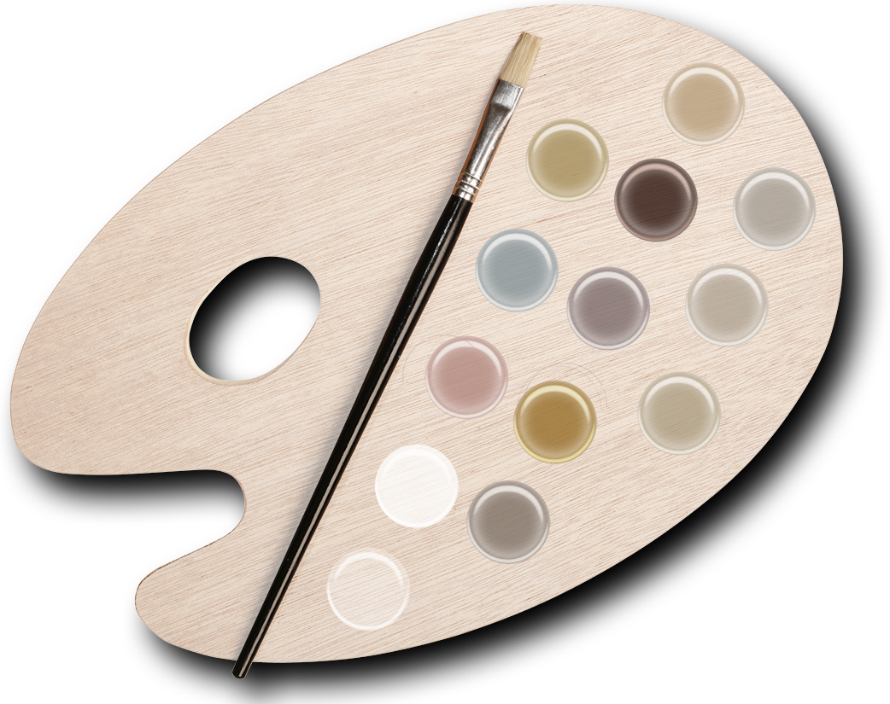
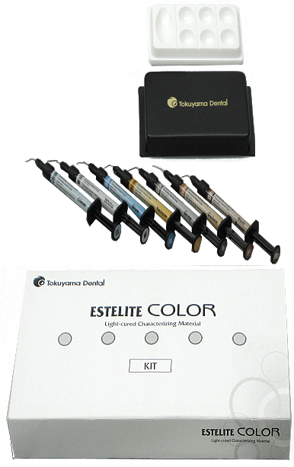
Compliment your restorations with Estelite Color
High
Chroma
Opaque
Yellow
Brown
Pink
Opaque
Blue
Lavender
Low
Chroma
Opaque
Red
Ochre
Medium
Chroma
Opaque
White
Grey
Clear

Slide 15
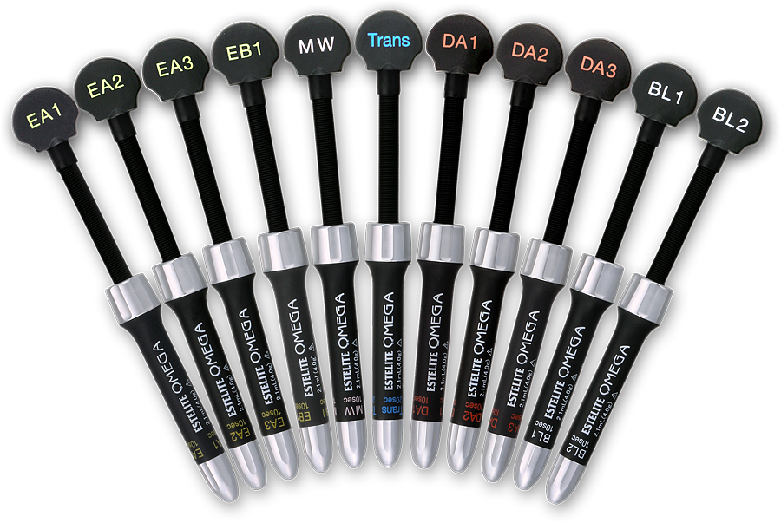
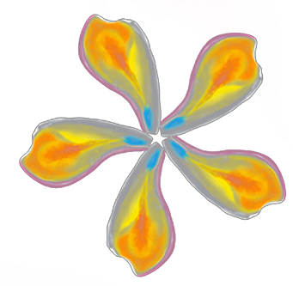
Estelite Omega
“With Estelite Omega your dental artistry will bloom into perfect nuances of color and form.”
– Newton Fahl, Jr.
Enamel
Lingual
Labial
Dentin
Pulp

